Slide 1
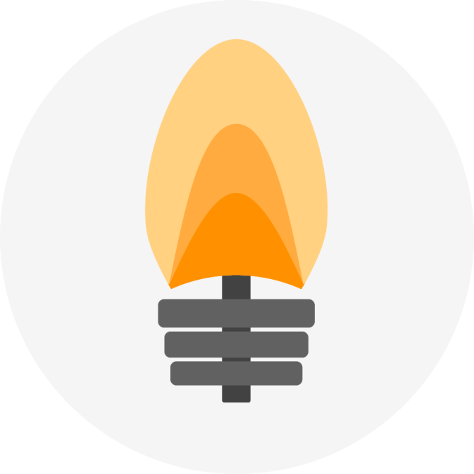
Burning Barbell
By: Stefano and Max

Slide 2
The Goal
Our goal was to create a simple and good looking app for our fake company.
To captivate our users with the many features of our app and eventually contact us.

Slide 3
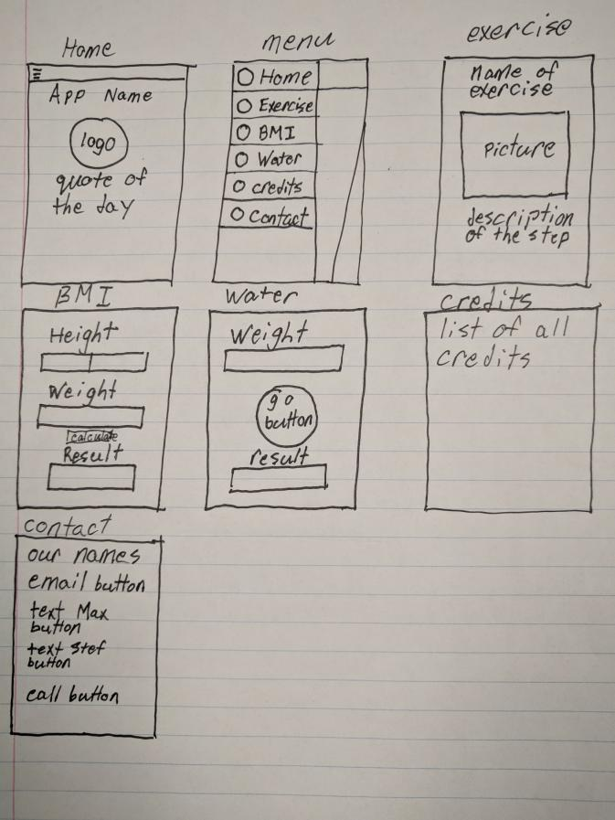
Our Original Concept
There is little difference from the app to our original design. We did decide to add the calorie log because both of us thought it was necessary to have.

Slide 4
Technology
We used GitHub to complete the project by being able to work off of what the other has worked on.
We used Discord to communicate to each other and to help solve issues we had.

Slide 5
Time
A big issue with the project was time, each fragment on the app took roughly 3-4 hours to make. The Calorie Log fragment took the most time taking roughly 5-6 hours to complete adding about 20 hours to complete the functionality and 5 extra hours to make the design of the app look good and crisp.

Slide 6
Tasks We Each Completed
Stefano
Calorie Tracker
Water Intake Calculator
Workouts
Home
Schedule
Max
BMI Calculator
Colours and Animations
Logo
Contact
Credits

Slide 7
Things We Had To Research
We needed some additional information about recycler views
We had to look up how to create custom animations and a splash page
How to use viewpagers with pictures

Slide 8
Hurdles We Had To Overcome
We wanted a Viewpager inside a RecyclerView to display our exercises but we figured out that there was no need to a ViewPager causing a lot of unneeded issues.
Completing school work and other projects while working on this was a pretty big hurdle because it did impact the amount of time we had to work on our app.

Slide 9
What we enjoyed
A big thing we enjoyed on building this project was how easy it was to work together while using git. With last year’s Java project it was almost impossible to work together because we had to save our folder and send it for someone else to work on it.

Slide 10
If We Were To Do It All Again, What Would We Do Differently?
If we were to do it all over again we would of loved to link the app to a database so you can see what you ate from a certain day no matter what day it is.

Slide 11
